Slide 1

Hiring Process Analytics
- A project report by JOSYULA ATHREYA SHARMA

Slide 2

A) Hiring
Project Description: In this task we had to find how many males and females were hired for different kinds of positions in the organization.
Approach: In order to perform this task we will use COUNTIF method in excel and the criteria would be “status”, “event_name” columns
Tech-Stack Used: MS Excel
Insights: This process is extremely useful to find how many people were hired based on the column “event_name”.
Result: The result will be an integer for both male and female event_name column basis.

Slide 3



Slide 4

B) Average Salary
Project Description: In this task we had to find the average salary offered by the company
Approach: In order to perform this task we will use “AVERAGE” method in excel and the criteria would be “salary” column.
Tech-Stack Used: MS Excel
Insights: The average salary is an important criteria used in companies for salary benchmarking and talent acquisition and also it is extremely helpful in investor and stakeholder transparency.
Result: The result will be a float value probably as attached below.

Slide 5



Slide 6

C) Class Intervals
Project Description: In this problem statement we have to find the class intervals in the company
Approach: The approach for this problem would be first we have to find max and min value of salary column and then we have to find the difference between the two , this would give us range of the column . Now we have to divide the intervals , for suppose we want to divide in interval of 5 we divide the range value with 5 .
Tech-Stack Used: MS Excel
Insights: Class intervals are used extensively for data analysis and visualization also used in salary analysis and reporting and employee segmentation.
Result: The result will be in a tabular format with three columns lower limit, upper limit and frequency.

Slide 7
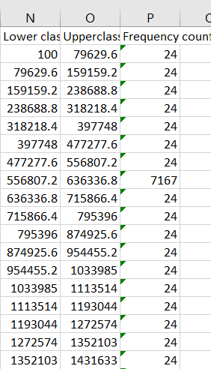

Slide 8

D) Charts and Plots
Project Description: The task is to draw a pie/bar graph to show proportion of people working in different departments.
Approach: we can solve this problem by using excel by selecting the column required and then going to insert in the excel we can choose the kind of chart we want and accordingly we can change the label names , colors etc.
Tech-Stack Used: MS Excel
Insights: Charts and plots are important aspects of data visualization which can be used for better understanding of the data even for naïve users.
Result: The result will be a pie chart as attached in the next slide

Slide 9
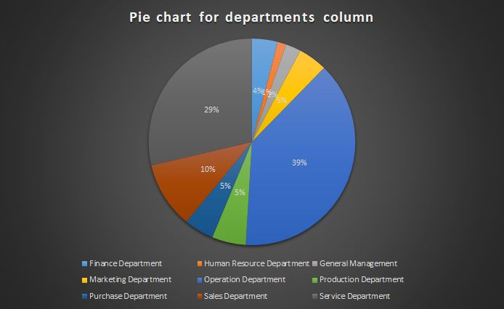

Slide 10

E) Charts
Project Description: Our task is to use different charts and graphs to represent post tiers in the statistics dataset.
Approach: The approach for this question is also same as the above in which we select the column name and after this we click on insert and select the type of chart/graph we want and then we can change the title ,colors used in the graph as per requirement.
Tech-Stack Used: MS Excel
Insights: Charts or graphs can be used to interpret the data more effectively than raw data and is used to make clients understand the data efficiently.
Result: The result would be a chart which is attached in the next slide

Slide 11
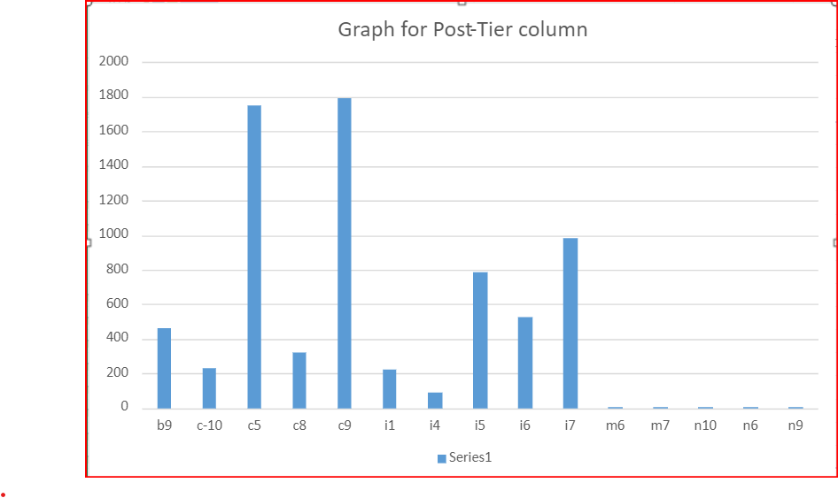

Slide 12

THANK YOU

